Slide 1
Past papers
A number of students have asked about past papers
This is the first year that COMP1753 has taught Python
last year (17/18) COMP1753 taught JavaScript
the previous year (16/17) there was a 30-credit course COMP1148 which also taught JavaScript and previously Java
You can get past papers for COMP1148 from the portal
but they are all in JavaScript or Java
Instead, we will give you some mock exam papers in the last two weeks of term

Slide 2
Loops
Chris Walshaw
Computing & Information Systems
University of Greenwich

Slide 3
Lecture Objectives
We will look at two different types of loop
while loops
for loops
We will also consider
the range() function
loop counters and how they work
the break and continue keywords
nested loops

Slide 4
Motivation
Many, many programs need to repeat the same operation over and over again, e.g.
a game updates the positions of all the characters / objects many times per second
a cash point repeatedly takes customers through the same sequence of operations
an mp3 player works its way through a playlist, playing each track in turn
These are achieved by loops in the program
Loops are a fundamental control structure in programming

Slide 5
Loops
Python (and most modern programming languages) have at least 2 types of loop
the while loop – the simplest to understand
the for loop – straightforward and the most commonly used
unlike other languages Python doesn’t do/while loops
We shall start with the while loop

Slide 6
The while loop
The syntax of the while loop is simple
while condition: code to be executed in the loop
The indented code is executed repeatedly whilst the condition is true
when the condition becomes false, the loop terminates and the code execution moves on to the statement after the loop
if the condition is not true initially, the loop contents are never executed
if the condition never becomes false, the loop will execute forever (or until the program is stopped externally) – this is known as an infinite loop
https://www.w3schools.com/python/python_while_loops.asp

Slide 7
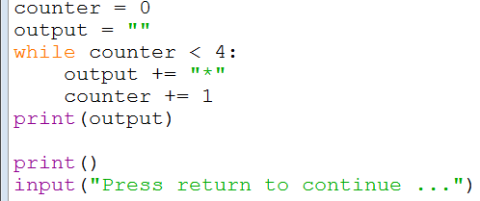
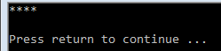
01Stars_whileLoopFixed
The first example just prints 4 stars
this number determines the number of stars: change it to 6 and you will get six; change it to 600 and you will get six hundred

Slide 8
The output string
Notice the output variable
output = ""
output += "*"
so after the first time around the loop output contains one star
after the second time round the loop output contains two stars, etc
We can follow this in the debugger: demo
the initial value is just an empty String
each time the loop contents are executed another star is added on the end

Slide 9
The += operator
We have seen how += glues a string (on the right-hand side) onto the end of string stored in a variable (on the left-hand side), e.g.
message += " you have 10% discount"
In the context of numbers, += adds the number on the right-hand side into the number stored in the variable on the left-hand side, e.g.
if name == "Chris Walshaw"
pay += 10000
So the following are equivalent and add 1 into the current value of counter
counter += 1
counter = counter + 1
Chris Walshaw is getting an extra £10,000

Slide 10
The for loop
The for loop is almost as straightforward
for some sequence of values: code executed in the loop
The indented code is executed repeatedly for each value in the sequence
https://www.w3schools.com/python/python_for_loops.asp

Slide 11
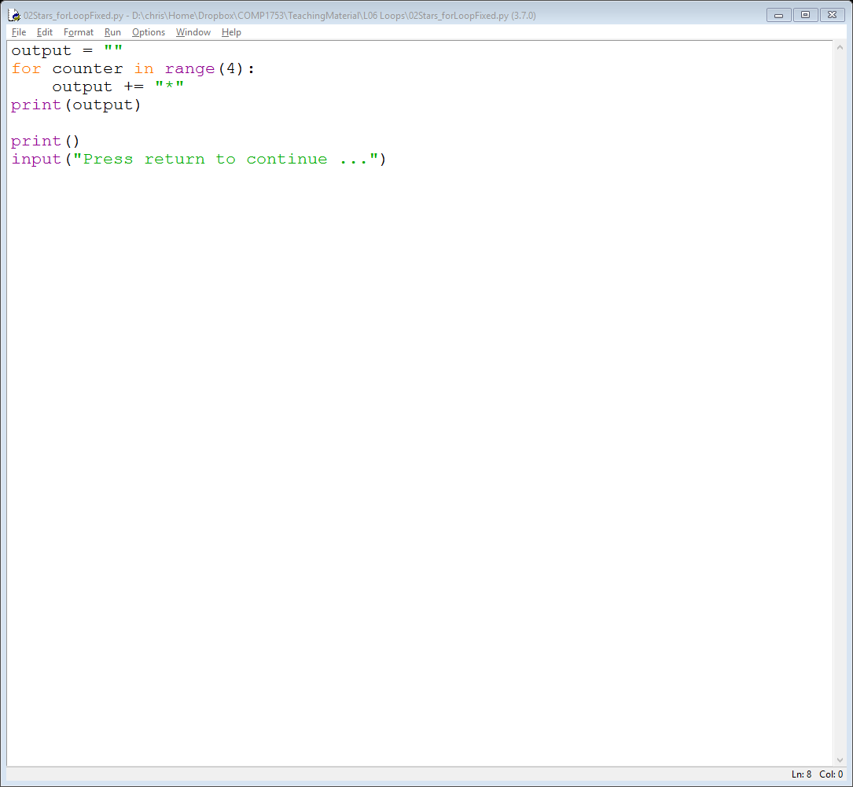
02Stars_forLoopFixed
This example produces exactly the same output as before – 4 stars
The code is a little shorter and neater than a while loop
this number determines the number of stars

Slide 12
The range() function
Many (most) Python for loops that you encounter will use the range() function to determine the sequence of values used in the loop
By default range(n) returns the sequence
starting from 0
ending at (just before) the specified number, n
incremented by 1 each time
So, for example:
range(4) produces the sequence 0, 1, 2, 3 …but not 4
range(6) produces the sequence 0, 1, 2, 3, 4, 5
range(2) produces the sequence 0, 1

Slide 13
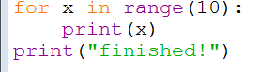
03Range_printCounter
If you want to check what values range() is producing, just print them out
NB you don’t have to use the variable name counter – here we use x

Slide 14
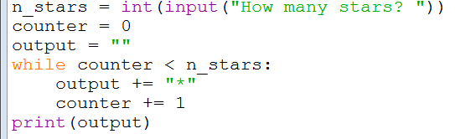
04Stars_whileLoop
Returning to the Stars examples, it is easy to let the user decide how many they want

Slide 15
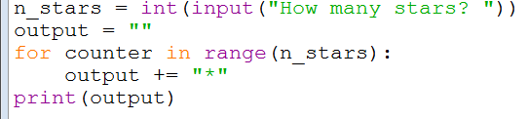
05Stars_forLoop
The same example using a for loop

Slide 16
for vs while
Notice the similarities in the use of counter
counter = 0
while counter < n_stars: code to be executed counter += 1
for counter in range(n_stars): code to be executed
In both cases, counter takes the values 0, 1, 2, 3
So which loop type should we use …

Slide 17
Which to use?
When writing loops with a counter it doesn’t really matter which you use
for is neater and keeps all of the loop controls in one place
for tends to be used when there is a fixed number of times to repeat the loop
while tends to be used when the number of repeats of the loop execution is uncertain
Some loops are not controlled by a counter, e.g. “while the arrow key is held down”, “while a game character is still alive”
for these it would make more sense to use while
You need to be familiar with both types of loop

Slide 18
range() continued
You don’t have to start from 0, e.g.
range(2, 6) produces the sequence 2, 3, 4, 5
You don’t have increment by 1, e.g.
range(0, 10, 2) produces the sequence 0, 2, 4, 6, 8
You don’t have to count upwards, e.g.
range(5, 0, -1) produces the sequence 5, 4, 3, 2, 1
start
end
start
end
increment
start
end
increment

Slide 19
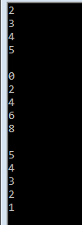
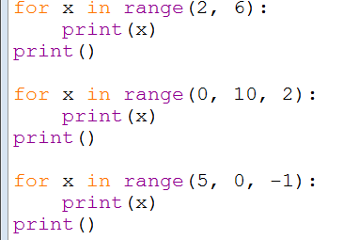
06Range_printCounters
Here are the above examples

Slide 20
Loop counters (1)
Very often loop counters start at 0 and run up to, but not including, the loop limit, e.g.
So
the loop limit is 4, specified as an argument to range()
the values of counter are 0, 1, 2, 3
the loop runs 4 times

Slide 21
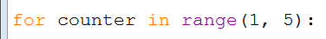
Loop counters (2)
However (provided the loop counter is not used inside the loop), this is no different to starting the counter at 1, e.g.
So
the values of counter are 1, 2, 3, 4
the loop still runs 4 times (up to, but not including, the loop limit 5)
Beginners sometimes prefer this

Slide 22
Loop counters (3)
But, as we will see (next week) loop counters almost always start from 0 when working with arrays
You should get used to both forms and be able to interpret what they mean
the simplest way is to work out which values the range() function provides

Slide 23
Quick check
How many times will the following loops run?
for i in range(3):
for i in range(4):
for i in range(1, 4):
for i in range(0, 4, 2):
for i in range(2, 3):
for i in range(4, 3):
for i in range(4, 4):
for i in range(40, 0, -1):
3 times: i = 0, 1, 2
4 times: i = 0, 1, 2, 3
3 times: i = 1, 2, 3
2 times: i = 0, 2
1 time: i = 2
0 times: 4 is >= 3
0 times: 4 is >= 4
40 times: i = 40, …, 1

Slide 24
More loops
Some of our previous examples are natural candidates for loops
The random number generator uses 4 identical lines of code to generate 4 random numbers
should be done with a for loop
Some of our programs which determine some response based on the user’s input could be used repeatedly
e.g. Concessions, Lucky numbers
could be done with a while loop

Slide 25
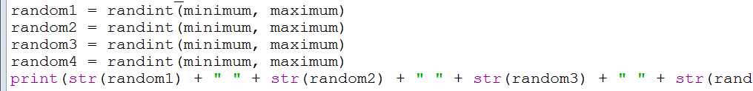
Random Values
In Lecture 02 we saw a program for calculating random values using the following code
14RandomValues.py
The problem is that this will only ever produce 4 random values
What if the user wants 20 random values?
we would need to add another 16 lines of code and variables

Slide 26
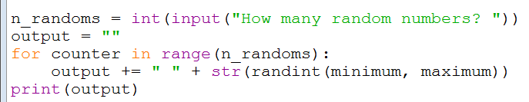
07Randoms_forLoop
With a for loop, 20 values is easy

Slide 27
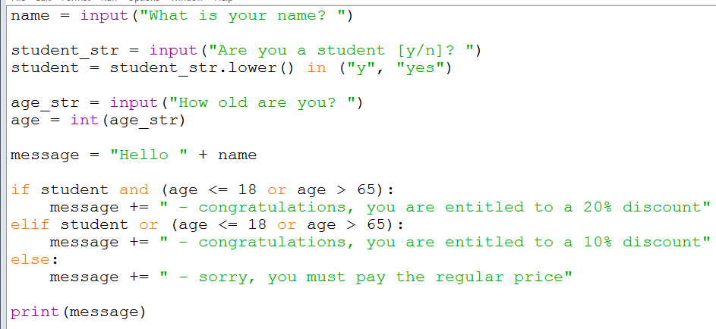
Concessions
In Lecture 03 we saw some code for calculating concessions
e.g. 14Concessions_orOperators.py
The problem is that for each new user we need to run the program again

Slide 28
Concessions (2)
An alternative is to put the main part of the program in a while loop
We could run the while loop indefinitely but it would be better to provide a way for the user to exit the loop without having to kill the program
A good way to do this is if the loop ends when no input is provided at the “What is your name?” prompt

Slide 29
Concessions (3)
The logic of the program is now
prompt the user for their name
while name contains some input
prompt the user for their status & age
calculate the concession
prompt the user for their name
The above is known is pseudo-code
it’s a bit like code, to help us understand the logic
but a computer would not understand it

Slide 30
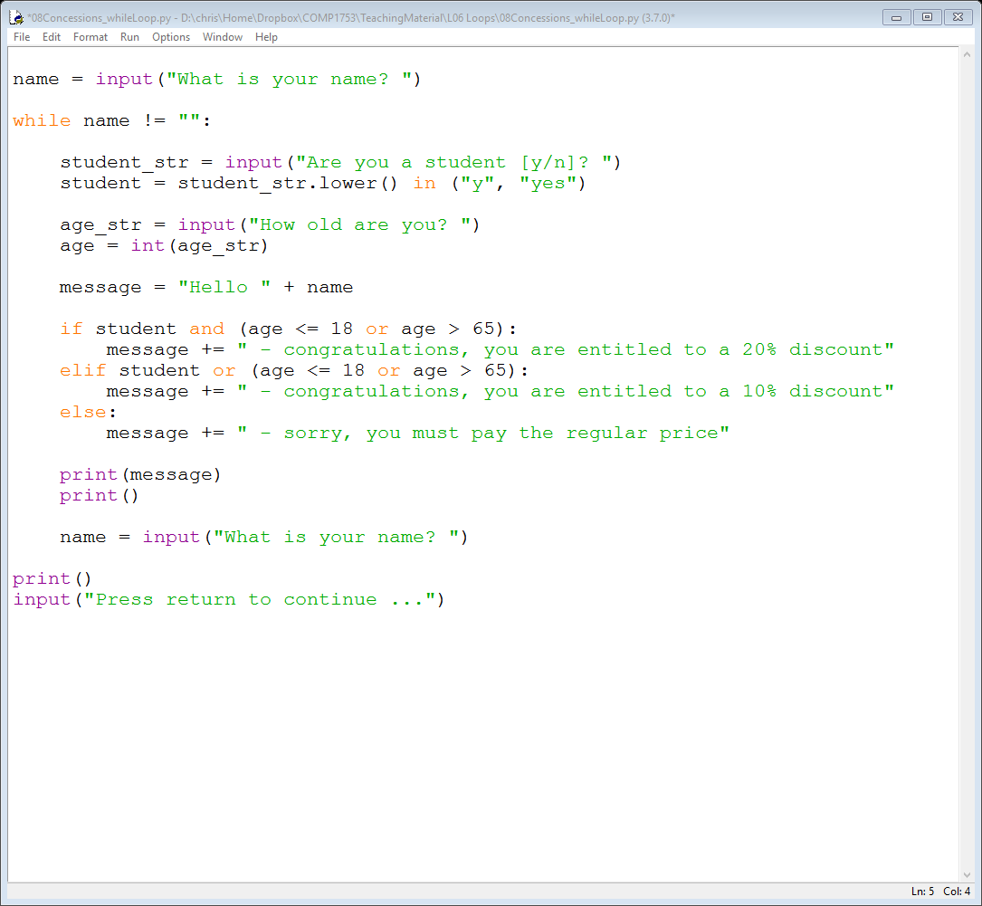
08Concessions_whileLoop
work out the concession message here
apart from being indented the code is unchanged

Slide 31
Other loop controls
There are two other loop controls we need to know about
break – to jump out of a loop before it’s finished
continue – to jump to the next time around a loop (ignoring the rest of the loop statements)
They are not used often, but they can be very useful!!

Slide 32
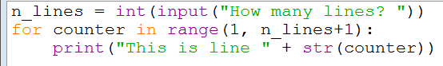
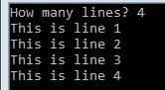
09LineNumbers
Example 09 just prints out the number of lines required by the user and shows it knows which is which
in this case the loop runs from 1

Slide 33
The break statement
You can use the keyword break if you need to jump out of a loop
Typically this might be used in a search
if the code is using a loop to search through some data (e.g. to find a particular customer) and locates the item it is looking for, there is no point continuing through the rest of the data

Slide 34
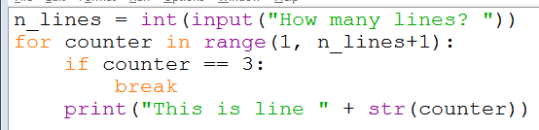

10LineNumbers_break
In this example the code will only ever draw a maximum of 2 lines regardless of how many the user has requested
before it has printed line 3
breaks out of the loop when counter is 3

Slide 35
The continue statement
You can use the keyword continue to move on to the next execution of the loop
it jumps to the start of the loop again, ignoring any statements further on in the loop
Typically this might be used to skip over some data
if the loop is processing some data (e.g. a list of bank accounts) it may want to ignore some of them (e.g. accounts that are closed)

Slide 36
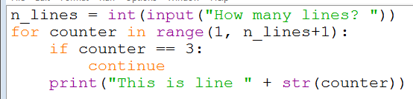

11LineNumbers_continue
In Example 11 the code will never print out “This is line 3” – it jumps straight to line 4
ignores the rest of the loop when counter is 3
no line 3

Slide 37
Nesting loops
It is quite common to nest one loop inside another, e.g.
while game is running:
for each character:
update character position
We shall look at some simple examples which generate text-based shapes (squares, rectangles, triangles, …)
but the principle is to understand nesting of loops

Slide 38
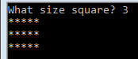
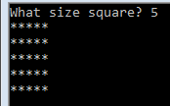
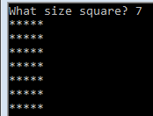
12StarSquare_forLoopFixed
Example 12 doesn’t use nested loops
Imagine we want to draw a rectangle (of stars)
the user controls how many rows there are
the number of columns is fixed at 5
3 rows, 5 columns
5 rows, 5 columns
7 rows, 5 columns

Slide 39
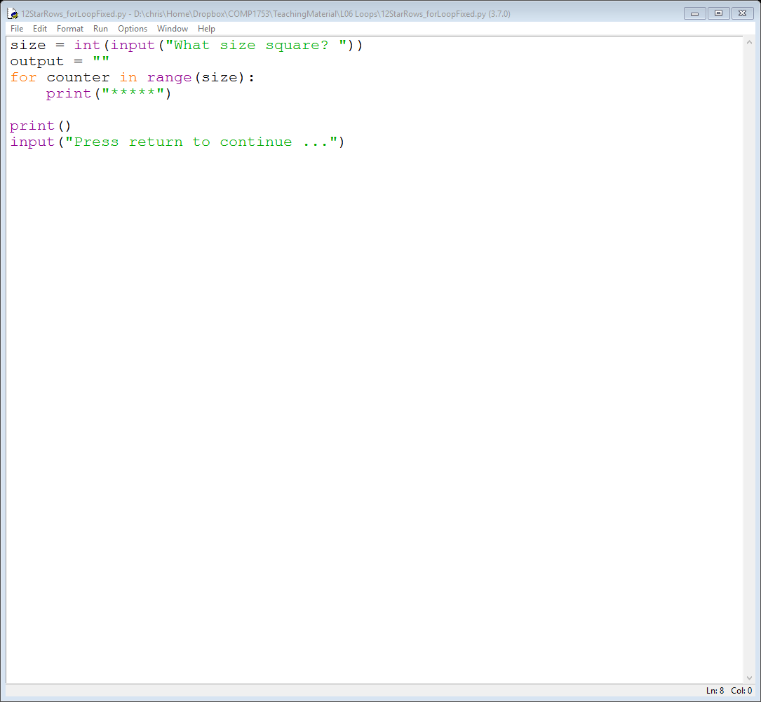
12StarRows_forLoopFixed
Example 12 just uses a for loop to print ‘rows’ of 5 stars
size controls the number of rows
but the number of columns is fixed (hardcoded) at 5

Slide 40
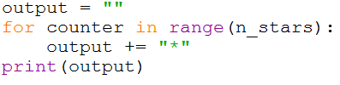
Variable size square (Example 13)
Suppose we want the number of rows and columns to match (to get a ‘square’ of stars)
We know how to produce a row of stars whose length is dependent on what the user has typed in
see 05Stars_forLoop.py
So we just have to replace
with something like

Slide 41
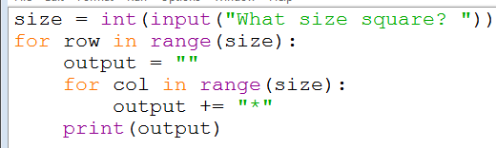
13StarSquare_nestedLoops
The resulting code is one loop nested inside another one
the original outer loop controlling the rows
the new inner loop controlling the columns

Slide 42
14StarRectangle_nestedLoops
Of course, we don’t need to make a ‘square’ we could ask the user
how many rows do they want?
how many columns do they want?
14StarRectangle_nestedLoops.py does just this
the rest of the code doesn’t change much

Slide 43
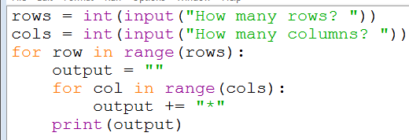
14StarRectangle_nestedLoops
Nested loops with different controls

Slide 44
Triangles (Example 15)
It is a simple modification to convert the output to triangles
To produce a triangle we need a different number of stars in each row
one star in the first row
two stars in the second row
three stars in the third row
So if we know which row we are producing (e.g. third row) we know how many stars are needed (e.g. three)
but don’t forget that the counter runs from zero so for the third row, the variable row is set to 2
so the number of stars we want is row+1

Slide 45
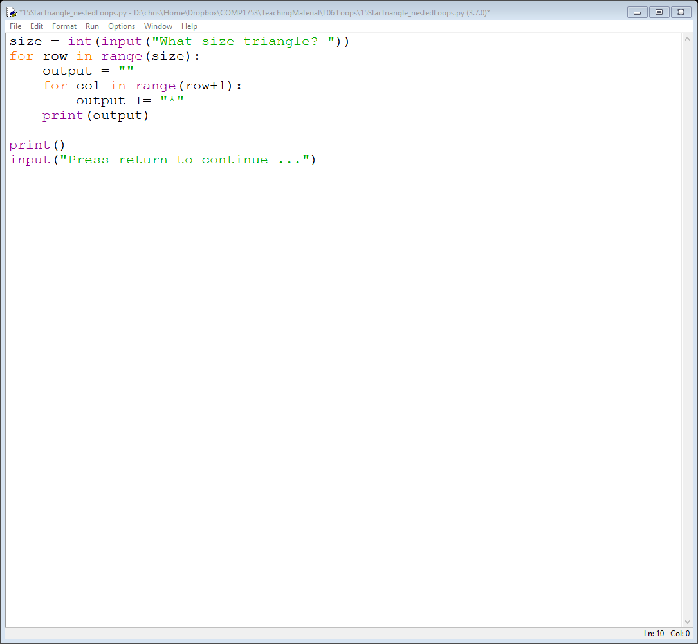
Triangles (continued)
The way to code this is to make the loop limit for the inner loop to be the row number
For example, for the third row
the variable row is set to 2
the inner loop runs 3 (= 2+1) times
the values of col are 0, 1, 2

Slide 46

Example 15 – code
Nested loops with variable loop limits
the change from size to row+1 is the only difference between this examples 14 & 15

Slide 47
Summary
Loops are used when the code needs to repeat the same operation over & over again
We have looked at
while loops
for loops
the range() function
the break and continue keywords
For the exam (and your career in programming) you will need to understand
both types of loop
range(), loop counters and how they work
nested loops

